Slide 1
Anomaly Detection in Images
Kapil Khond – A20445656
Sourav Yadav – A20450418

Slide 2

What is an anomaly and applications of anomaly detection :
An Anomaly refers to a data instance that is significantly different from other instances in the dataset.
Applications of Anomaly detection
intrusion detection
fraud detection,
fault detection,
system health monitoring,
event detection in sensor networks,
detecting ecosystem disturbances.

Slide 3
UCSD dataset
Train set – 34 videos (200 frames each)
Test set – 36 videos (200 frames each)

Slide 4
Train Set

Slide 5
Test Set

Slide 6
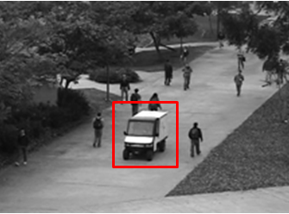
Problem Statement
Anomalies to detect :
the circulation of non pedestrian entities in the walkways
anomalous pedestrian motion patterns

Slide 7
Autoencoder
Autoencoder is an unsupervised artificial neural network that learns how to efficiently compress and encode data then learns how to reconstruct the data back from the reduced encoded representation to a representation that is as close to the original input as possible.
Autoencoder, by design, reduces data dimensions by learning how to ignore the noise in the data.

Slide 8
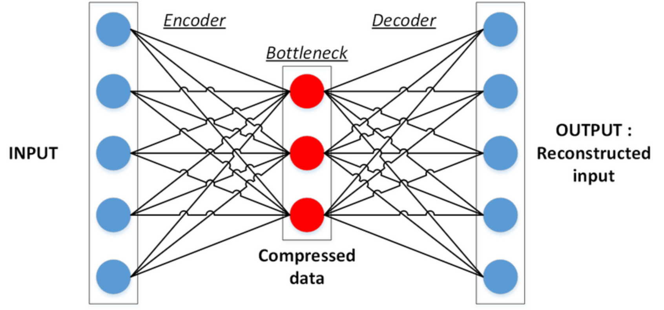
Autoencoder consists of two parts
Encoder
The Encoder is tasked with finding the smallest possible representation of data that it can store - extracting the most prominent features of the original data and representing it in a way the decoder can understand.

Slide 9
Autoencoder consists of two parts
Decoder
Learns how to restore the original data from that encoding generated by the Encoder.
These two are trained together in symbiosis to obtain the most efficient representation of the data that we can reconstruct the original data from, without losing so much of it.

Slide 10
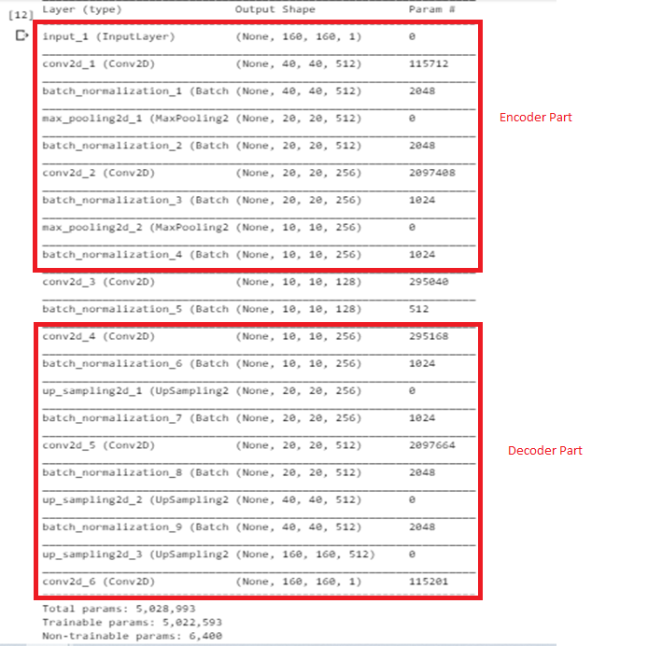
Convolutional Autoencoder Architecture

Slide 11
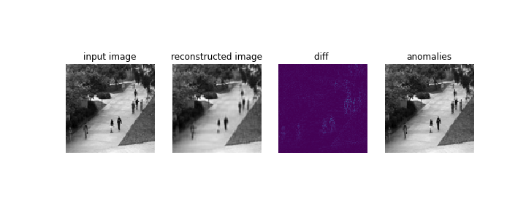

Image Reconstruction Without Anomaly

Slide 12
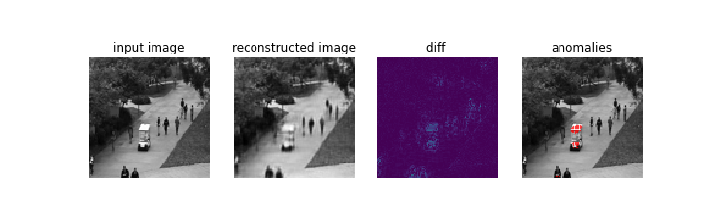
Image reconstruction with Anomaly (Car)

Slide 13
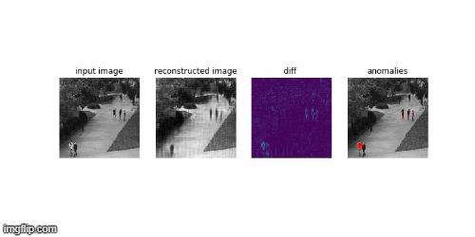

Slide 14
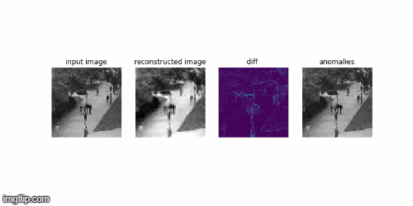

Slide 15
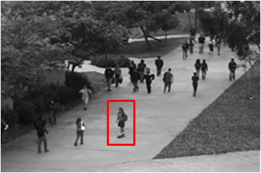
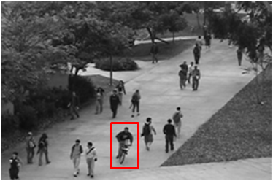
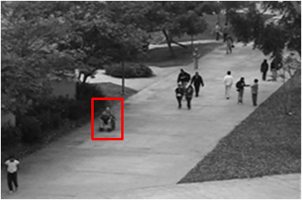
Future Work
We successfully detected cars, people walking across a walkway or in the grass that surrounds it
In future we will try to detect anomalies like bikers, skaters, wheelchair.

